Slide 1
A Spatial Query Language for 3D Building Models and 3D City Models
Agnes, Fahad

Slide 2
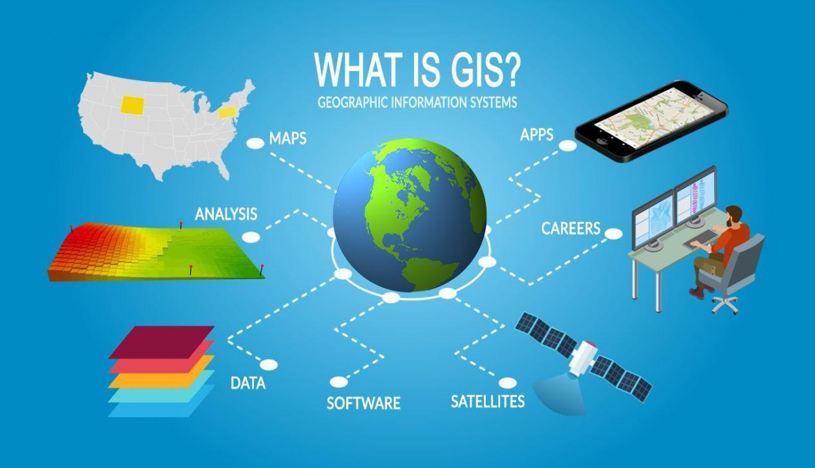
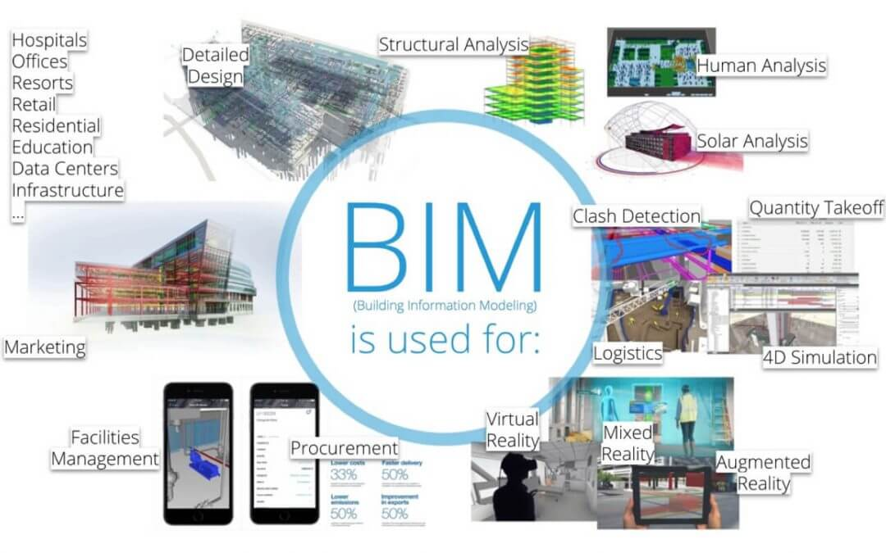
GIS and BIM
Notes:
metric (closerThan)
directional (above)
Topological (touch, within)

Slide 3

Motivation
Existing query languages for BIM only performed alphanumeric comparisons on individual attributes of the object-oriented mode.
To compare qualitative spatial relations, the author applied GIS concepts on the BIM domain
Notes:
metric (closerThan)
directional (above)
Topological (touch, within)

Slide 4


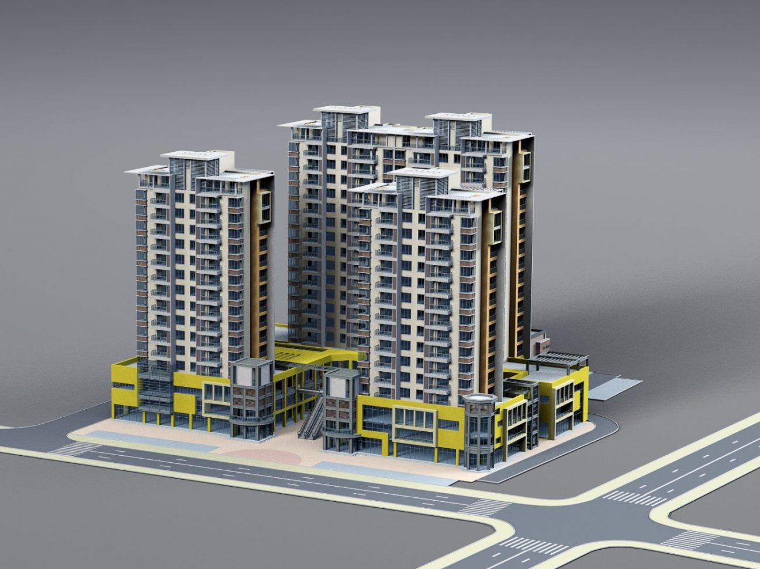
Introduction
Notes:
metric (closerThan)
directional (above)
Topological (touch, within)

Slide 5
The new SQL?
Spatial Query Language for 3D building and 3D city models
Language provides metric, directional, and topological operators in SQL statements
Metric | Directional | Topological
closerThan | Above | Touch
fartherThan | Below | Within
 | NorthOf | Contain
Notes:
metric (closerThan)
directional (above)
Topological (touch, within)

Slide 6
Possible queries
Get all walls within the first story
Does room 107 contain any heating equipment?
Get all fire extinguishers within the distance of 40m from a certain door.
Which columns touch Slab No. 13?
Are there any gas lines below the footing?
Rephrase this to explain why these queries are important in the first place

Slide 7
Prior Work
Author | Contribution
Ozel et al. (2000) | CAD systems provide sophisticated functionality for geometric modelling but they lack comprehensive spatial analysis capabilities
Groger et. al (2004) | Oracle Spatial, a commercial db system is limited to 2D even though it is possible to store simple 3D geometry
Beunig et. al (1994 & 2001) | GeoToolkit, object oriented framework for storing and accessing 3D geographic and geologic data. Main disadvantage - everything needs to be modelled according to mathematical concept of simplical complexes. Converting boundary representations like the ones in CAD to simplical complex representations is just too expensive.

Slide 8
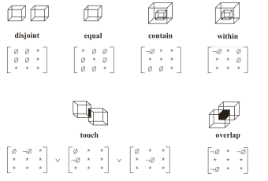
Spatial Types and Operators
Notes:
Relies on spatial algebra

Slide 9
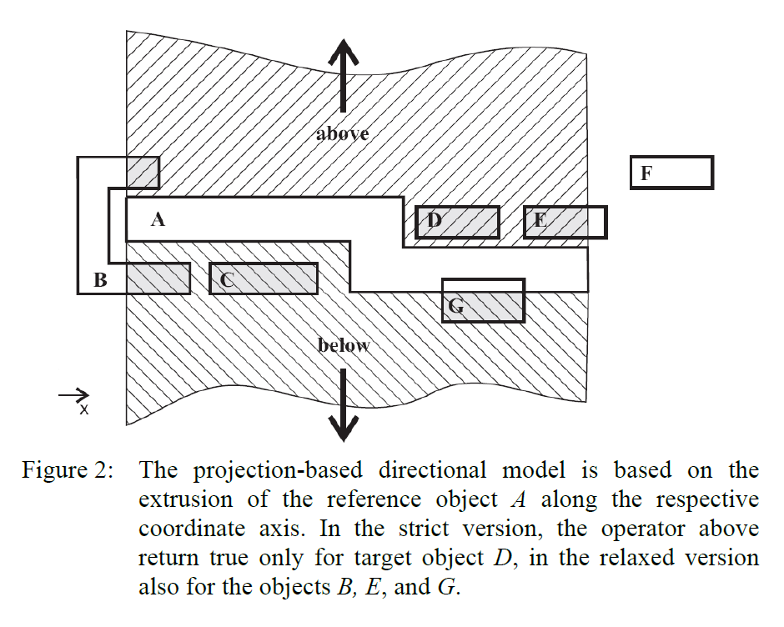
Projection based model
Notes:
applied operator returns true if there is an intersection between the extrusion body and the target object. For the relaxed version it is sufficient if parts of the target object intersect the extrusion body, for the strict version the target object has to be completely within the extrusion body

Slide 10
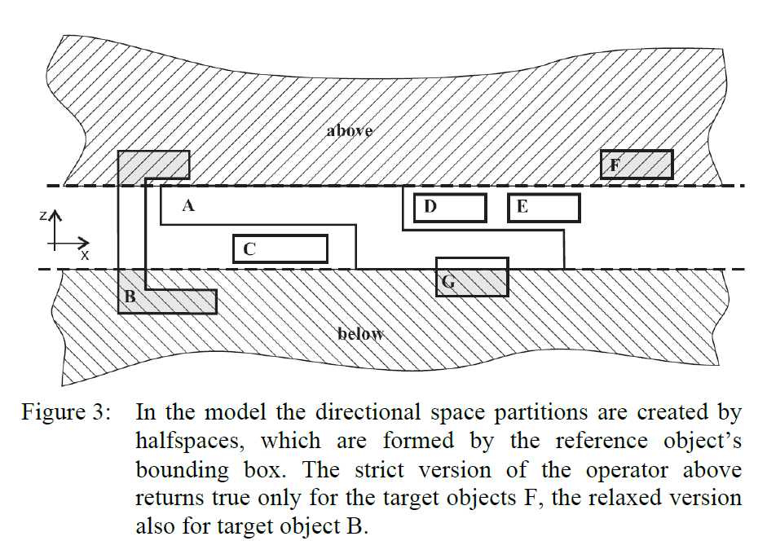
Half-space model
Notes:
applied operator returns true if there is an intersection between the extrusion body and the target object. For the relaxed version it is sufficient if parts of the target object intersect the extrusion body, for the strict version the target object has to be completely within the extrusion body

Slide 11
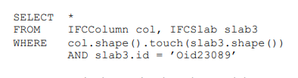
Sample Query 1

Slide 12
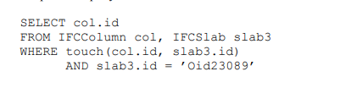
Sample Query 2

Slide 13
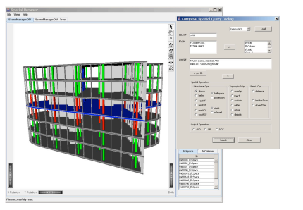
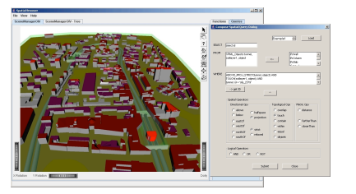
Screenshots of Prototype
Notes:
The first screenshot shows all the beams that touch the blue slab. The second screenshot shows all buildings that are above the subway.

Slide 14
Expanded Works

Slide 15
Querying 3D Cadastral Information from BIM Models
BIM: building information modeling
Paper aims to develop BIM-based queries for interrogating questions about the legal ownership of properties inside multistorey buildings

Slide 16
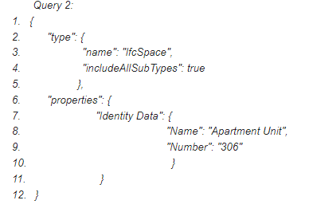
Example: retrieve the legal space of the apartment unit 306

Slide 17
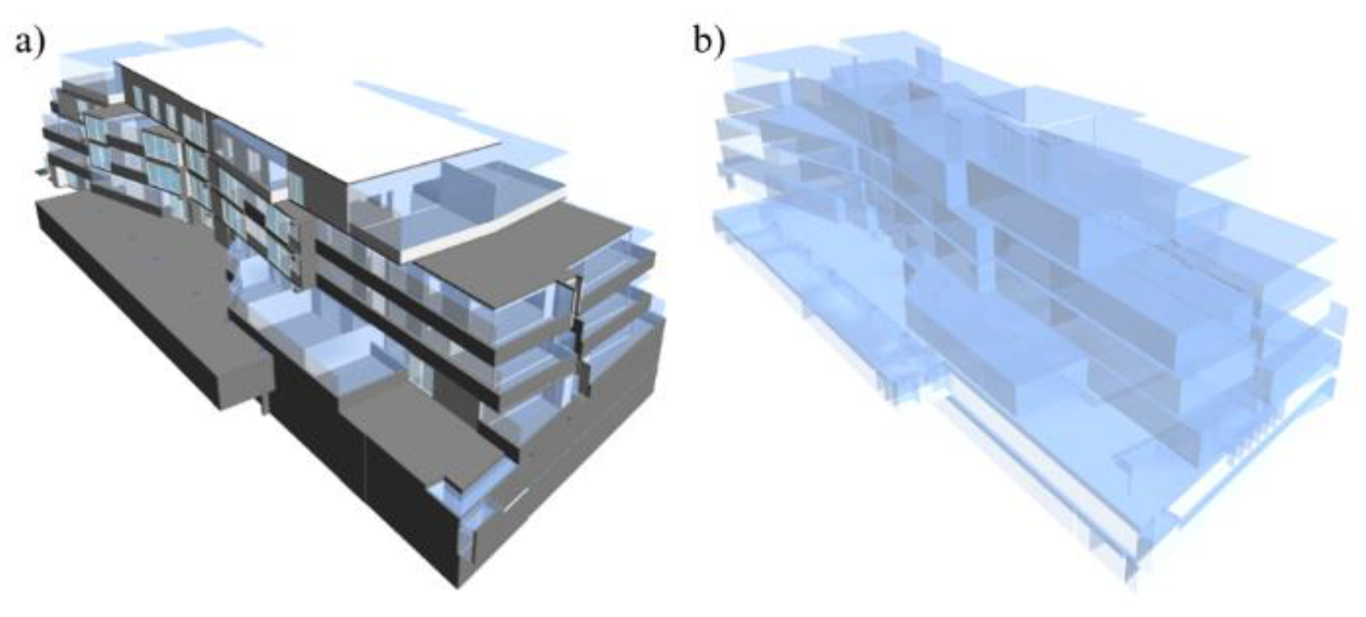
Result of example

Slide 18
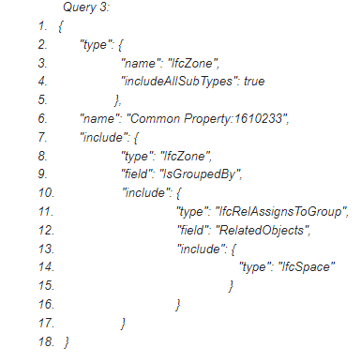
Example: legal spaces defining a common property zone in the BIM model

Slide 19
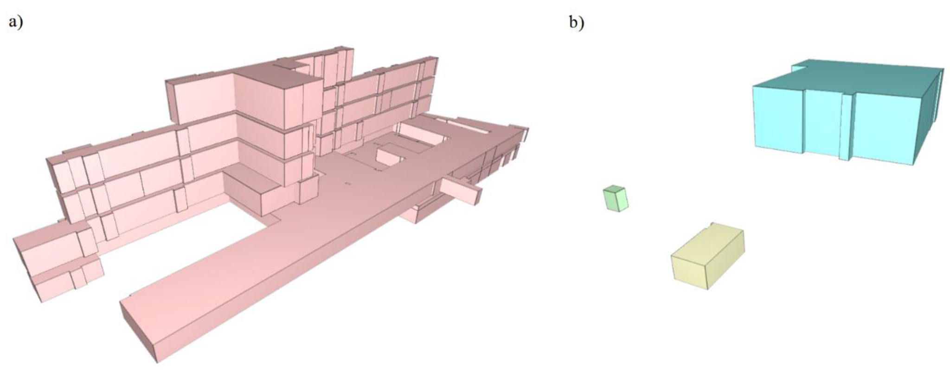
Result of example

Slide 20
Geospatial Data Management Research
five milestones of geospatial data management research are presented that were achieved during the last decade
Advancing GIS/BIM Integration at Data, Process, and Application Levels
Advancing Topology as a Key Concept for Geospatial Data Management
Advancing 3D/4D Geospatial Data Management
Modelling and Visualization of Massive Geospatial Features on Web Platforms
Extensive Use of Geosensor Data Sources

Slide 21
Future Directions
GeoSpatial Data Science : process geospatial data quickly and generate added value, need CityGML for city models
Database Support for GeoSpatial Data Analysis: consider use of AI/ML, how to integrate geospatial-, spatio-temporal methods into new systems
geoAI methods will be used for geospatial data cleansing, to detect and learn errors in geospatial data sets
tools will be supported by geospatial data management systems that split the data into geospatial or spatio-temporal partitions to organize parallel database accesses

Slide 22
References
130_1_3DGeoInfo_borrmann_final (isprs.org)
IJGI | Free Full-Text | Querying 3D Cadastral Information from BIM Models (mdpi.com)
IJGI | Free Full-Text | Geospatial Data Management Research: Progress and Future Directions (mdpi.com)

